Slide 1
DMGfit Overview
Notes:
In this presentation:
The relationship between the plasticity-damage model (DMG), and the model calibration tool (DMGfit)
Implementations of DMGfit: for users on stand-alone PCs, or for Web-based users
The overall model calibration strategy
The calibration process specific to the DMG
The mapping of the calibration process to the DMGfit GUI
Labor saving features in the GUI, requested by MSU researchers
DMGfit demo

Slide 2
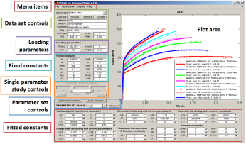
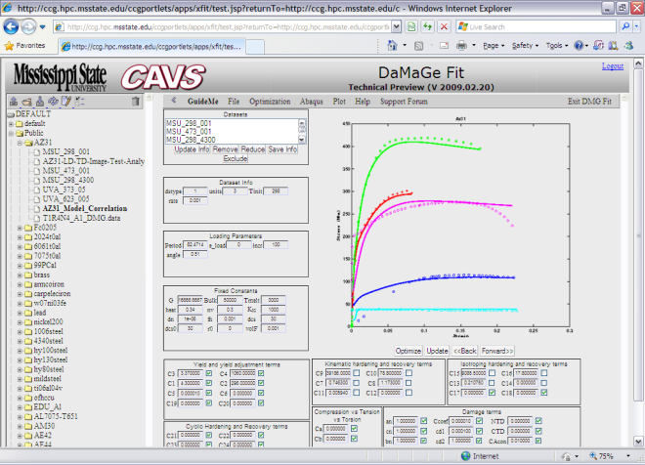
DMGfit – Calibration tool for the MSU ISV Plasticity-Damage (DMG) Model, v.1.0
DMG UMAT
(Fortran)
Material Point
Simulator (Fortran)
Stand-alone
DMGfit (MATLAB)
Outputs:
- Constants to ABAQUS
input deck
- Curves to PamStamp2G
material card
Model calibration wrapper (MATLAB)
DMGfit Web
Service
M.F. Horstemeyer
Y. Hammi
R.L. Carino
T. Haupt
Material Properties Repository
http://ccg.hpc.msstate.edu/cmd
Notes:
DMG UMAT – model code, for ABAQUS FEA
Material Point Simulator – numerical integration routine, mimics ABAQUS for single element
Model calibration wrapper – implements the logic for model calibration
Stand-alone DMGfit – for users on Windows/Linux desktops/laptops that may not have a network connection
DMGfit web service – for users on the WWW
Material Properties Repository – a component of the CAVS-CMD CyberInfrastructure which stores experimental data, models, and model calibration tools

Slide 3
Model calibration in DMGfit
User inputs
Optimizer
Initial model constants
Generate candidate constants
props()
Material point simulator
Model stress-
strain
No
Experimental stress-strain
Good
fit ?
Yes
props()
statev()
strain(i), stress(i),
statev()
Optimized
model constants
Damage model
UMAT

Slide 4
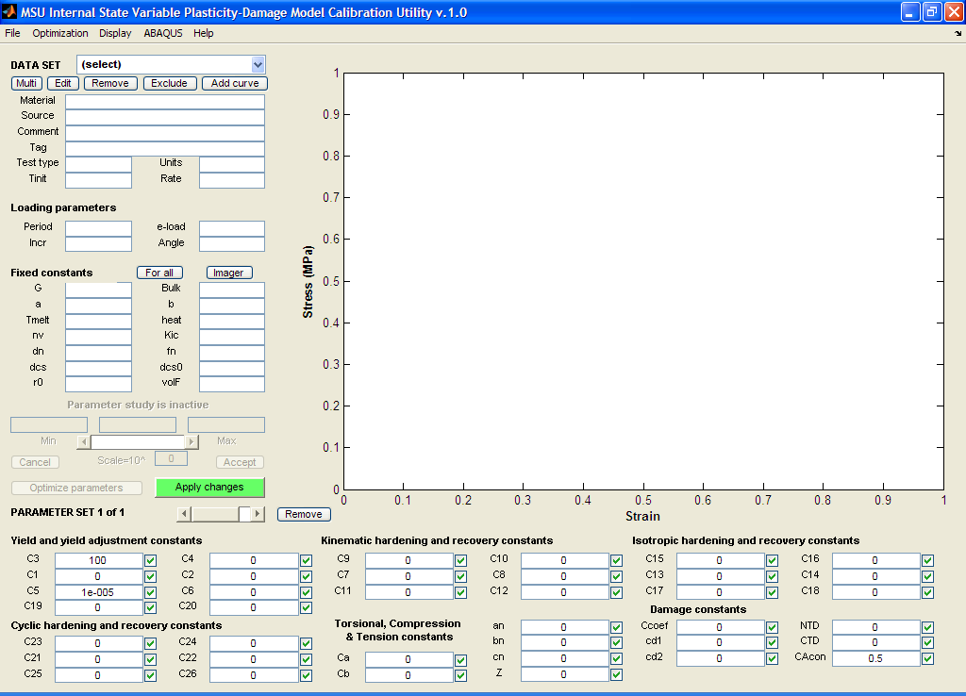
DMGfit GUI and calibration strategy
A
Update the GUI regions in the ff. order:
Datasets
Loading parameters
Fixed constants, microstructure
Yield and yield adjustment
Kinematic hardening and recovery
Isotropic hardening and recovery
Cyclic range hardening and recovery
Torsional, Compression and Tension
Damage
B
C
D
E
F
G
H
I

Slide 5
Dataset – a text file containing name= value
# Format: name= value
model_tag= DMG
material= az31-ND
G= 16666.7
Bulk= 50000
a= 0
b= 0
Tmelt= 3000
heat= 0.34
Kic= 1000
nv= 0.3
fname= MSU1
source= Matt Tucker
comment= normal direction
excluded= 0
dstype= 1
units= 3
Tinit= 298
dn= 1e-006
fn= 0.001
dcs0= 30
dcs= 30
r0= 0
volF= 0.001
period= 82.4714
rate= 0.001
incr= 100
angle= 0.51
e_load= 0
(continued in next column)
(continuation)
# Experimental data (must be the last “name= value”)
strain, stress=
0 0
0.00127973 5.73677e+007
0.00248207 1.14556e+008
0.00473197 1.5983e+008
0.00843224 1.88483e+008
0.0129067 2.08455e+008
0.0177175 2.24879e+008
0.0227565 2.39103e+008
0.0280123 2.51231e+008
0.0334448 2.6178e+008
0.039026 2.70922e+008
0.0446936 2.79572e+008
0.0505404 2.86634e+008
0.0565043 2.92804e+008
0.0628393 2.95111e+008
0.0691321 2.98455e+008
0.0755729 3.00528e+008
0.0824714 2.96166e+008
More detailed sample
datasets in training disc

Slide 6
Typical sequence of steps
Load all experimental datasets. For each dataset, establish the experiment settings (initial temperature, strain rate, stress units, etc), loading parameters, and fixed constants.
First fit the dataset with the lowest temperature and lowest rate. If there are different tests, fit the compression datasets first, followed by tension datasets, then torsion datasets.
For the first dataset, adjust the constants as follows: yield C3; kinematic hardening C9 and recovery C7; isotropic hardening C15 and recovery C13.

Slide 7
Typical sequence of steps (cont)
Restore second dataset. If it has a different temperature than the first, adjust the constants as follows: {C3, C4} if yield is temperature dependent; then {C10, C8, C16, C14}. If the dataset has a different strain rate, adjust C1 and C5 if yield is strain rate dependent, then {C9, C7, C11} and {C15, C13, C17}.
Repeat step 4 for the rest of the datasets. If adjusting the temperature dependence constants (even Cs) does not produce good models for high temperature data, adjust C19 and C20. Adjust torsion, compression and tension differentiation constants, if adding stress state dependent experimental data.

Slide 8
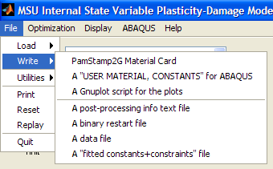
Typical sequence of steps (cont)
Adjust damage constants. To track the evolution of the damage state variable, select Display | Plot a state variable | Damage. Readjust constants in other boxes as necessary.
Record results
- Merge constants into an ABAQUS input deck
- Write curves to PamStamp2G format
- Create comma separated values (CSV), for MS Excel
- Create a restart file

Slide 9
DMGfit demo example - AZ31
Datasets
MSU1: Matt Tucker, 298K, 0.001/s, Tension
MSU2: Matt Tucker, 473K, 0.001/s, Tension
MSU3: Matt Tucker, 298K, 4300/s, Tension
UVA1: Sean Agnew, 373K, 0.05/s, Tension
UVA2: Sean Agnew, 623K, 0.005/s, Tension

Slide 10
Step 1
Load all experimental datasets. For each dataset, establish the experiment settings (initial temperature, strain rate, stress units, etc), loading parameters, and fixed constants.

Slide 11
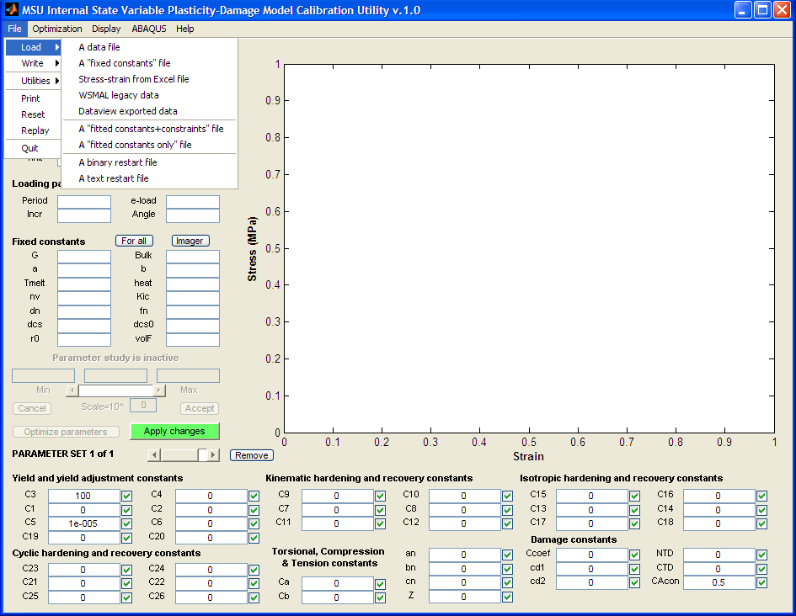
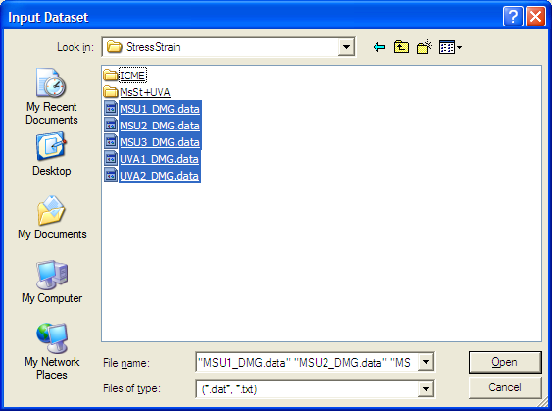
Load datasets
File | Load | A data file …
Select datasets

Slide 12
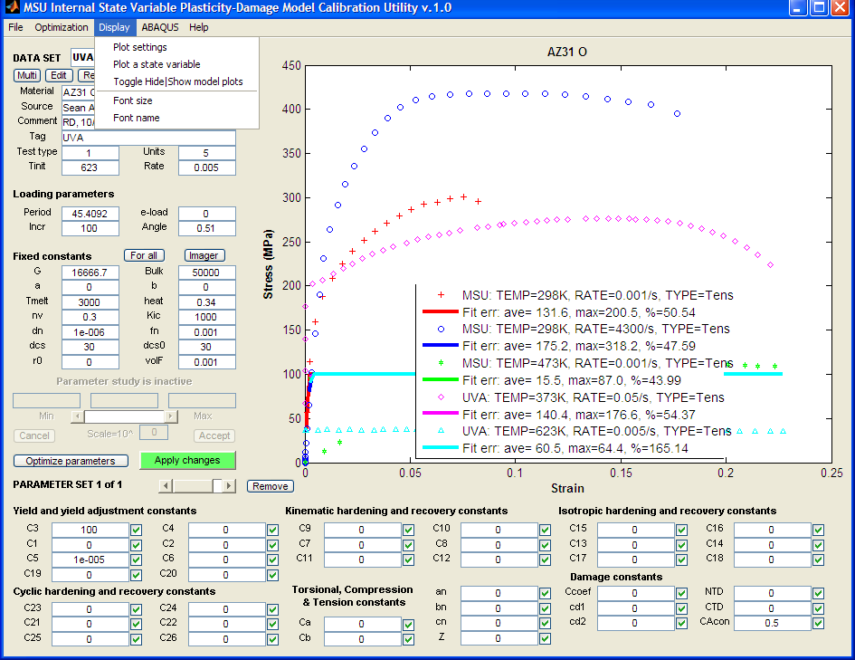
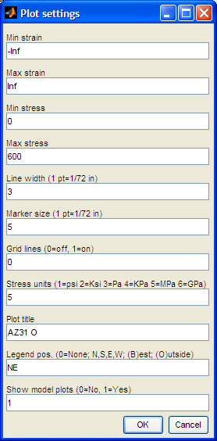
Edit plot settings
Stress: 0-600
Legend: NE
(northeast)

Slide 13
Step 2
First fit the experimental dataset with the lowest temperature and lowest rate. If there are different tests, fit the compression datasets first, followed by tension datasets, then torsion datasets.

Slide 14
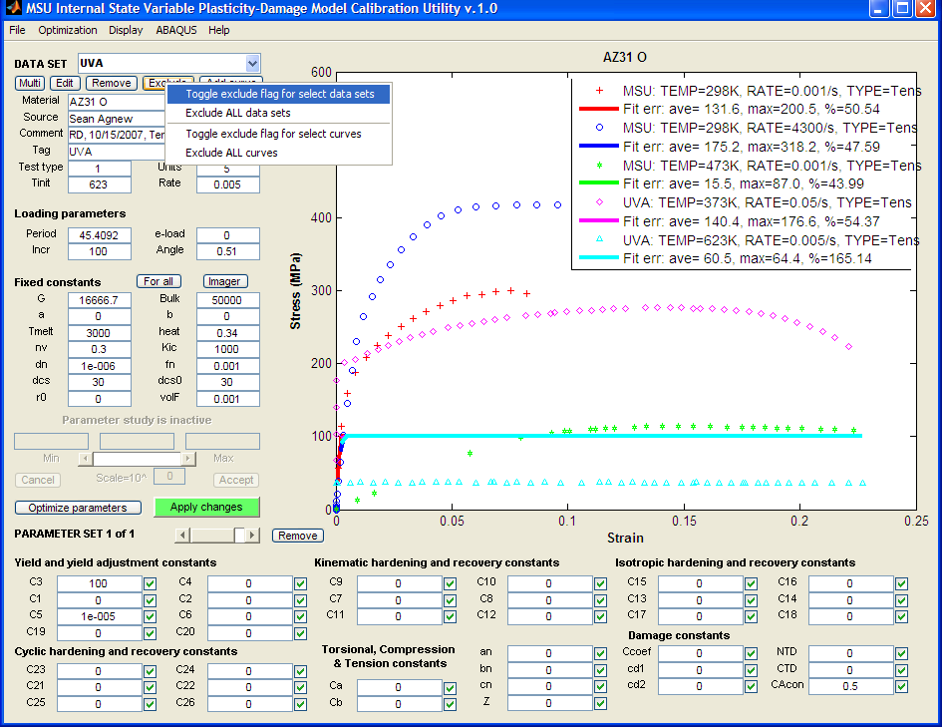
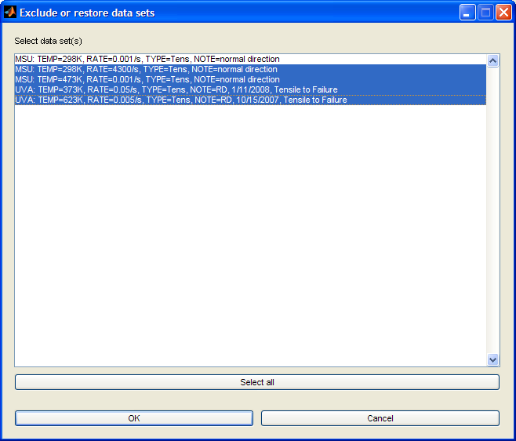
Start with MSU1 (lowest temp, lowest rate dataset)
a. Right-click “Exclude”
then select “Toggle… datasets”
b. Select all, except lowest
temp. & lowest rate
c. Click OK

Slide 15
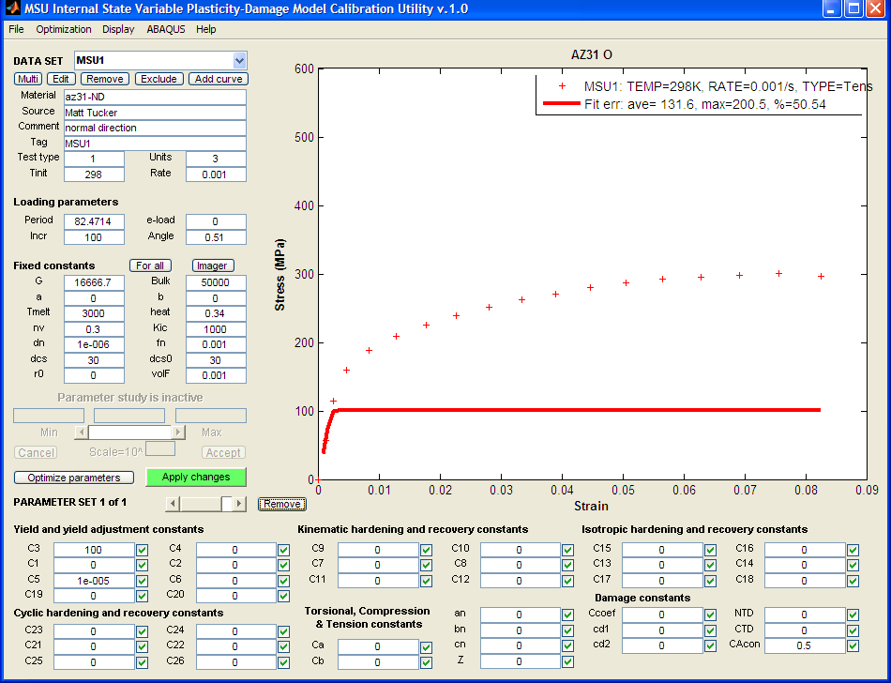
The first dataset
Click on a data point
to display dataset info
on left panel
Model curve based on
default parameters

Slide 16
Step 3
For the first dataset, adjust the constants as follows:
yield C3;
kinematic hardening C9 and recovery C7;
isotropic hardening C15 and recovery C13.

Slide 17
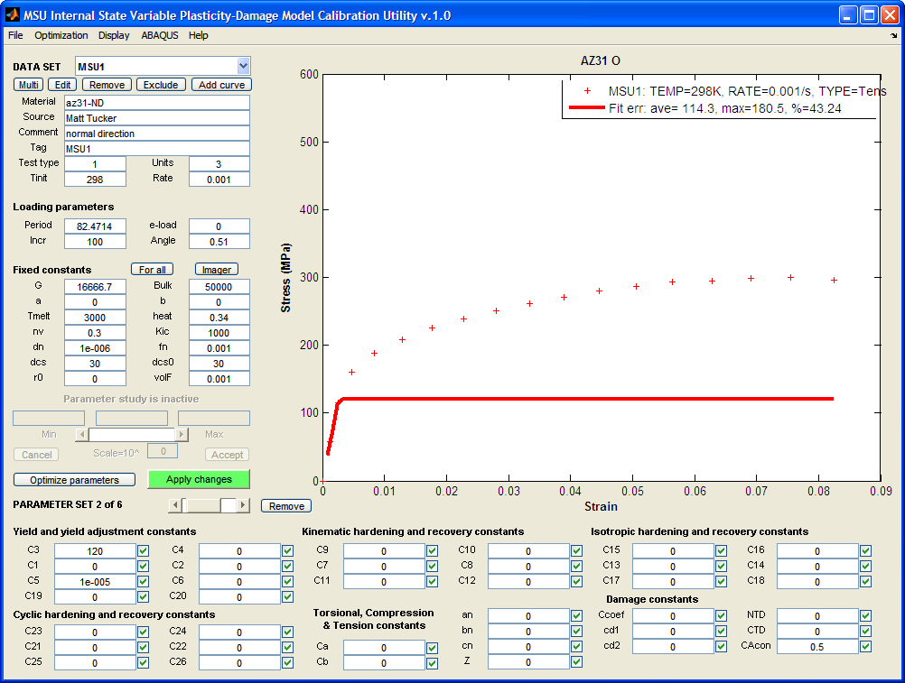
Adjust yield: C3=120, “Apply changes”
Notes:
Remember to click “Apply changes” after modifying one or more edit boxes or check boxes.

Slide 18
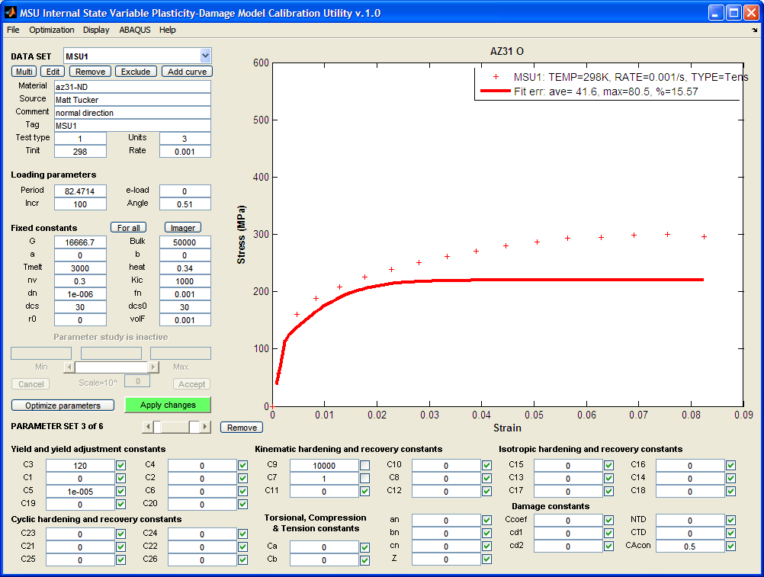
Add kinematic hardening and recovery: C9=10000, C7=1, uncheck; “Apply”; “Optimize”

Slide 19
After “Optimize parameters” C9 and C7

Slide 20
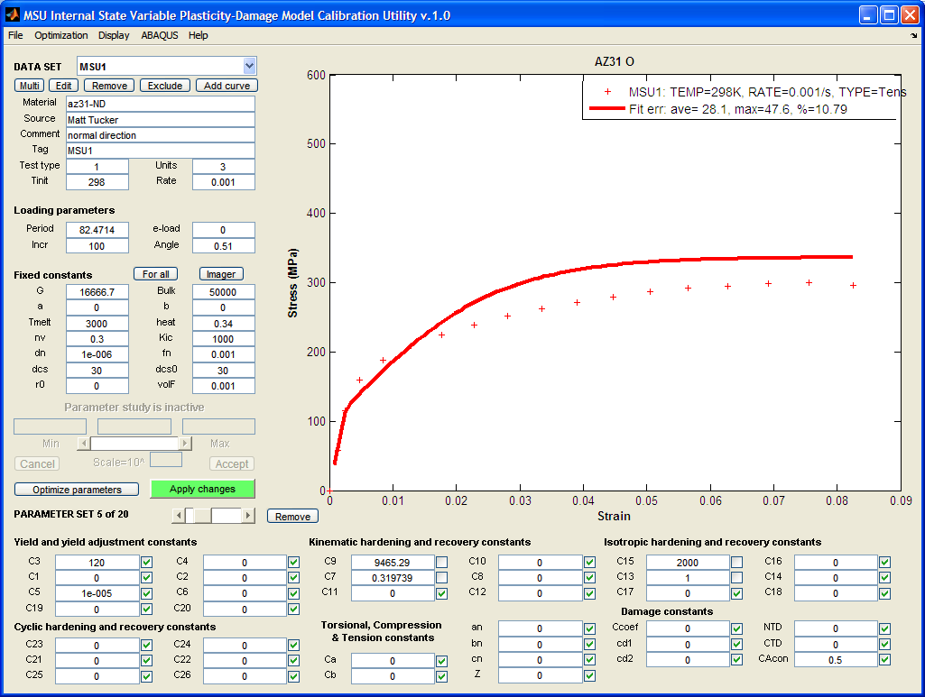
Add isotropic hardening and recovery: C15=2000, C13=1, uncheck; “Apply”; “Optimize”

Slide 21
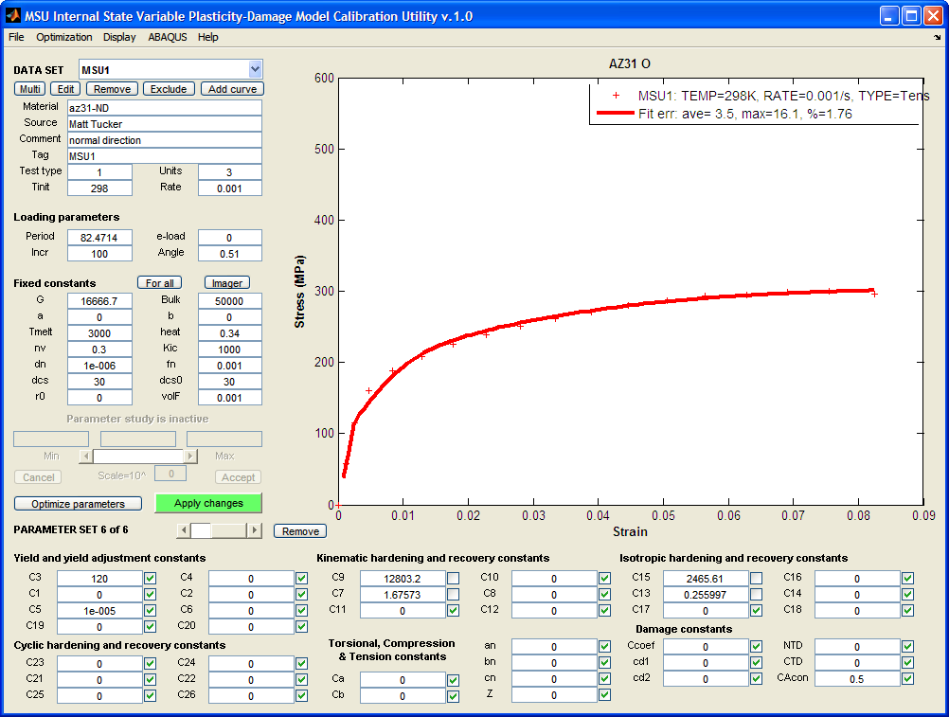
After “Optimize” {C9, C7} and {C15, C13}

Slide 22
Step 4 - Restore second dataset.
If it has a different temperature than the first, adjust the constants as follows:
{C3, C4} if yield is temperature dependent;
{C9, C10; C7, C8};
{C15, C16; C13, C14}.
If the dataset has a different strain rate, adjust
C1 and C5 if yield is strain rate dependent;
{C9, C7, C11};
{C15, C13, C17}.

Slide 23
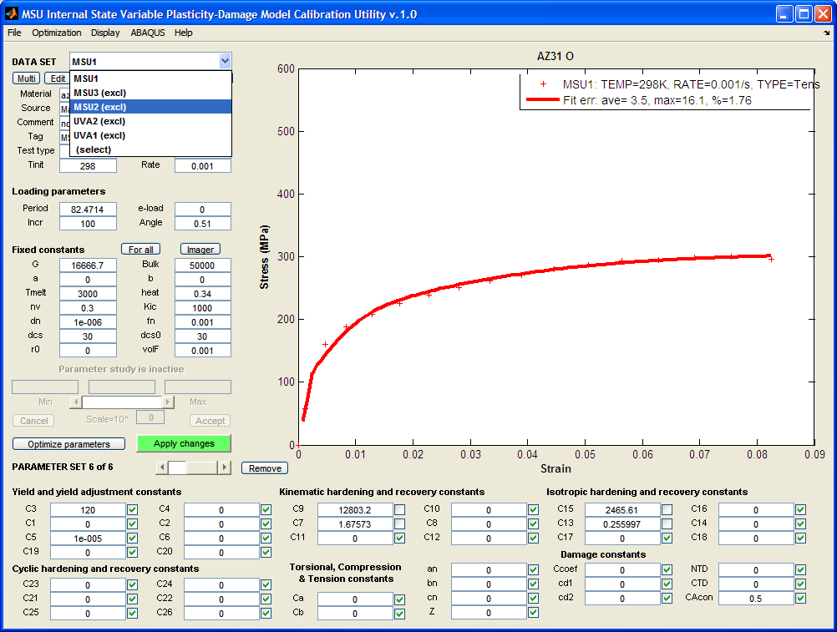
Select MSU2 (excl)

Slide 24
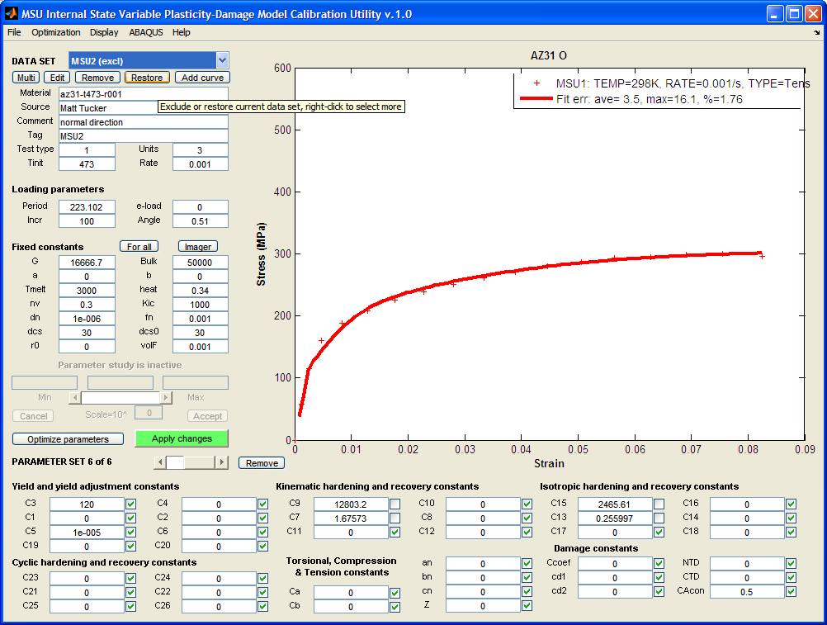
“Restore” MSU2 (higher temp. than MSU1)

Slide 25
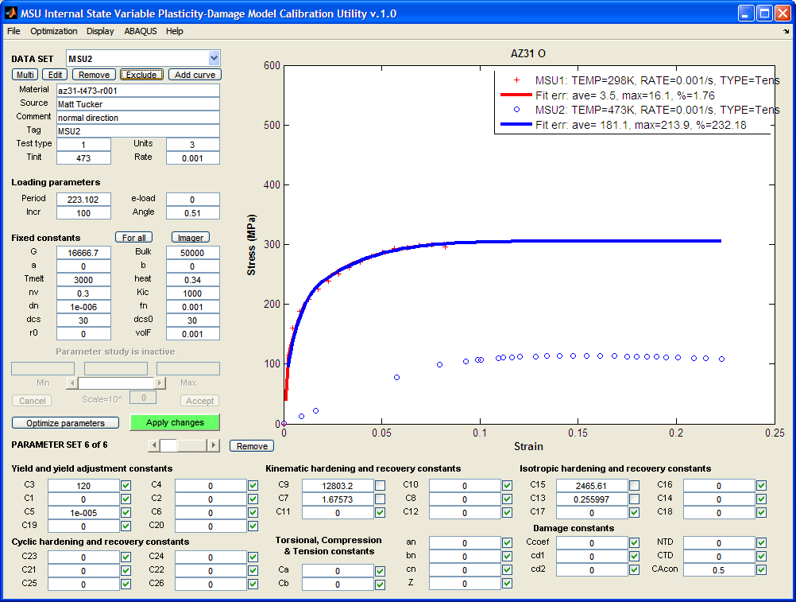
MSU1 already fitted; MSU2 just restored

Slide 26
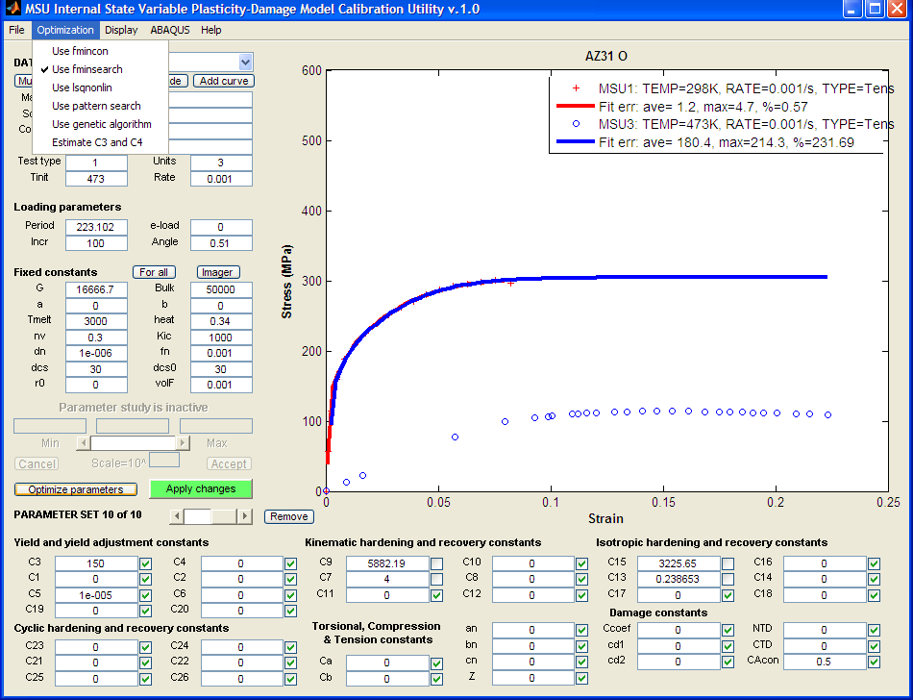
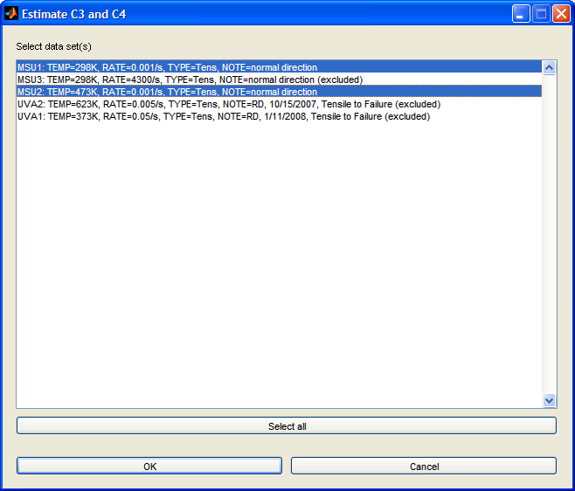
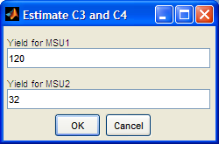
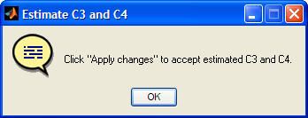
Add temperature dependence to yield: Estimate C3 & C4 from MSU1 & MSU2
Optimization | Estimate
C3 and C4
b. Select MSU1, MSU2
c. Enter 120 for MSU1,
32 for MSU2
d. OK
e. OK
b
a
c
d
e

Slide 27
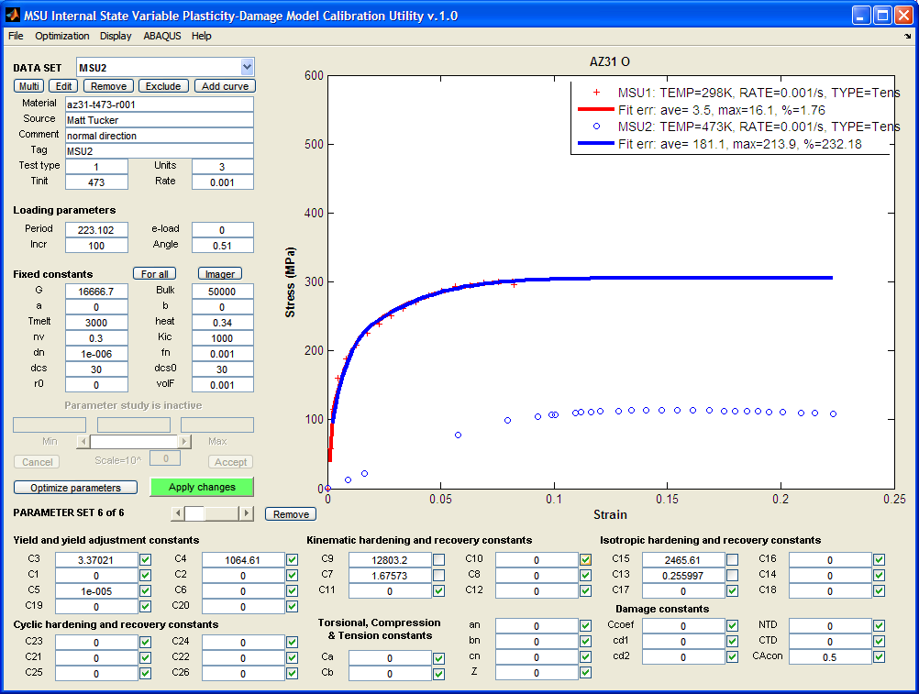
C3, C4 automatically estimated

Slide 28
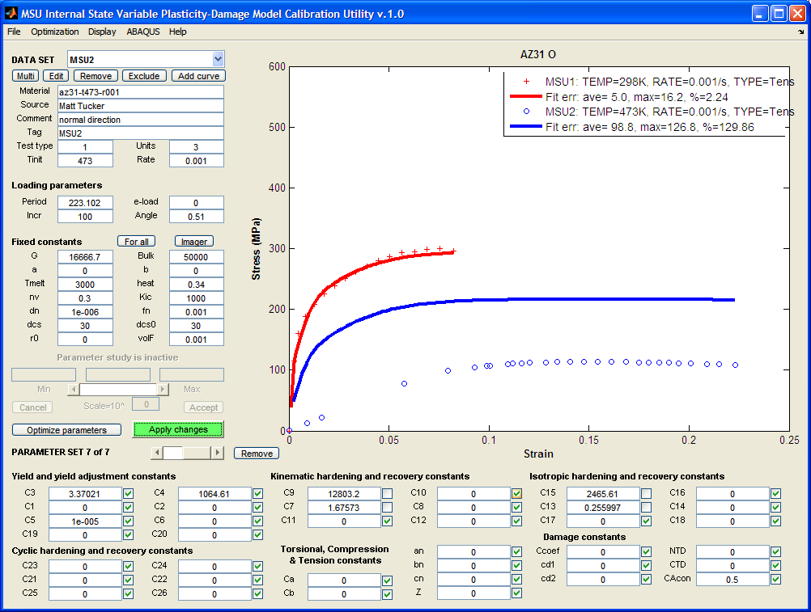
After “Apply” C3, C4

Slide 29
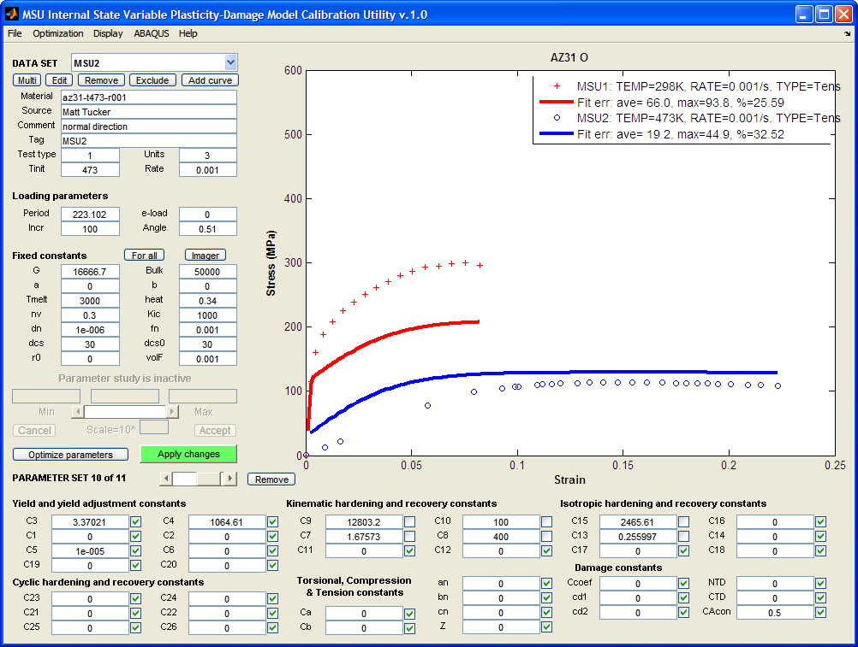
Add temp. dependence to kinematic hardening & recovery: C10=100, C8=400, uncheck; “Apply”; “Optimize”

Slide 30
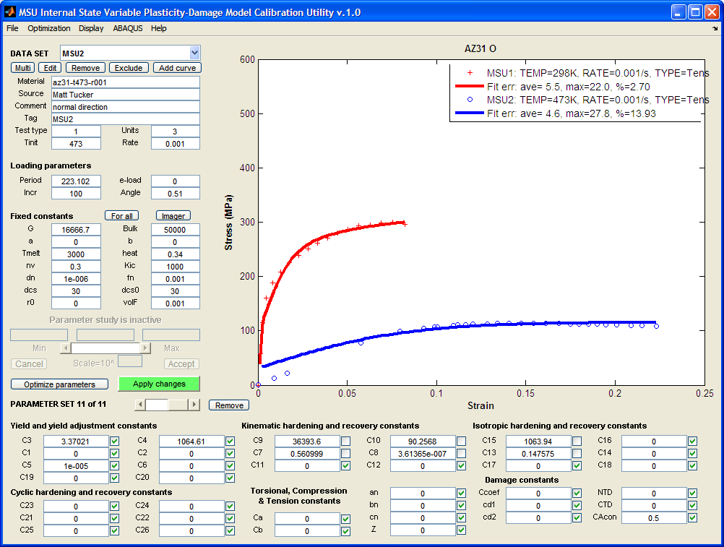
After “Optimize”

Slide 31
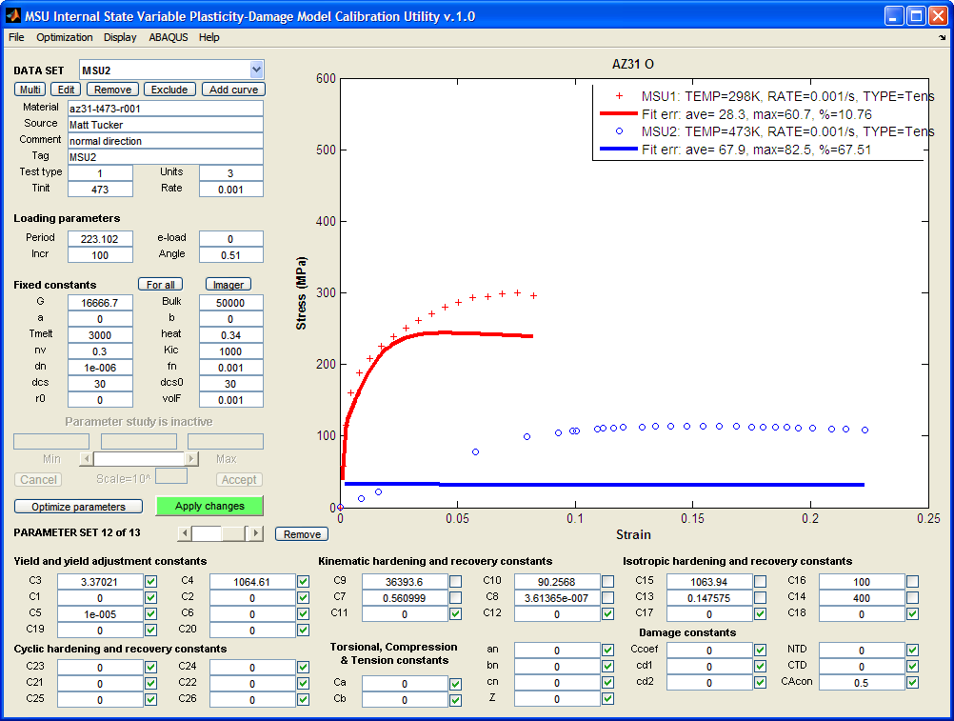
Add temp. dependence to isotropic hardening & recovery: C16=100, C14=400, uncheck; “Apply”; “Optimize”

Slide 32
After “Optimize”

Slide 33
Step 5
Repeat Step 4 for the rest of the datasets. If adjusting the temperature dependence constants (even Cs) does not produce good models for high temperature data, adjust C19 and C20. Adjust torsion, compression and tension differentiation constants, if adding stress state dependent experimental data.

Slide 34
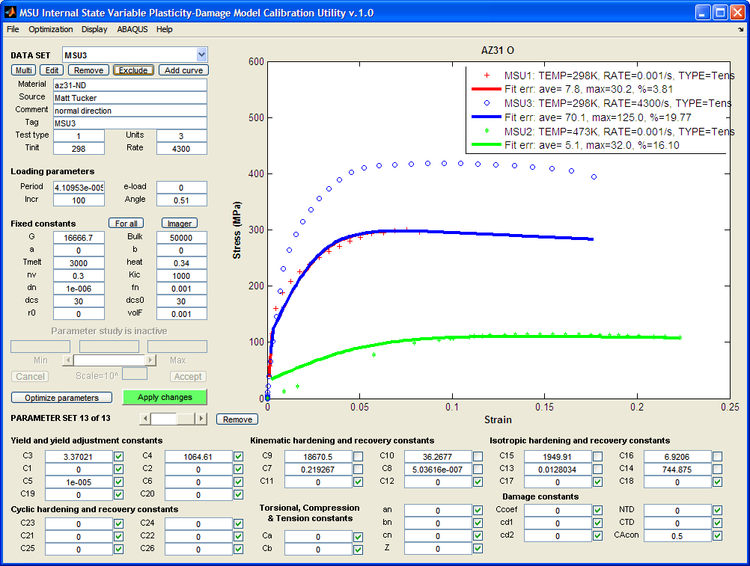
Restore MSU3 (excl), for higher rate

Slide 35
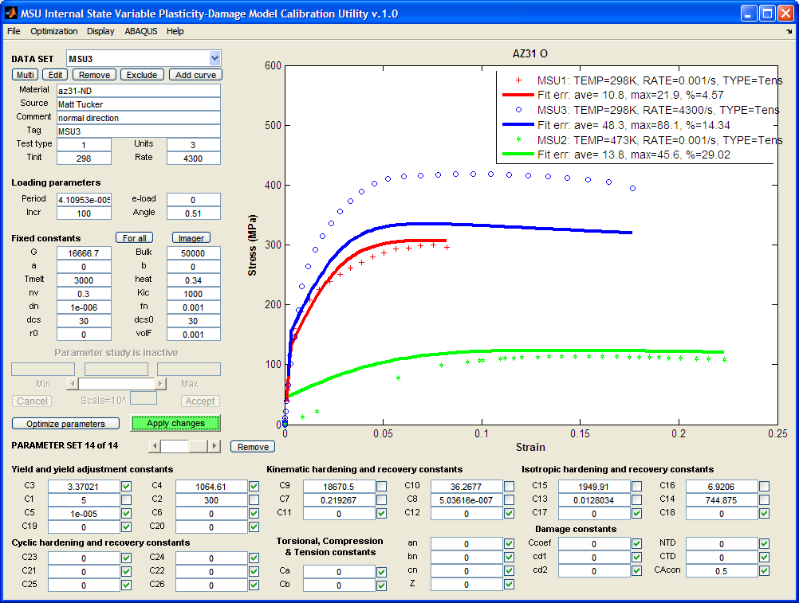
Add rate dependence to yield: C1=5, C2=300, uncheck; “Apply”; “Optimize”

Slide 36
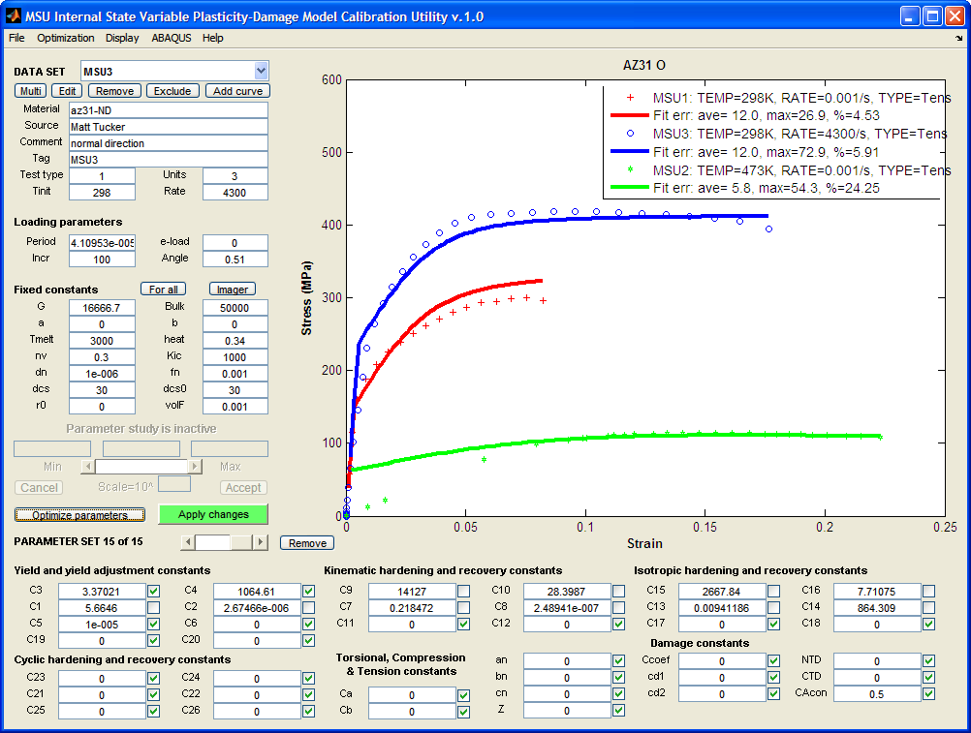
After “Optimize”

Slide 37
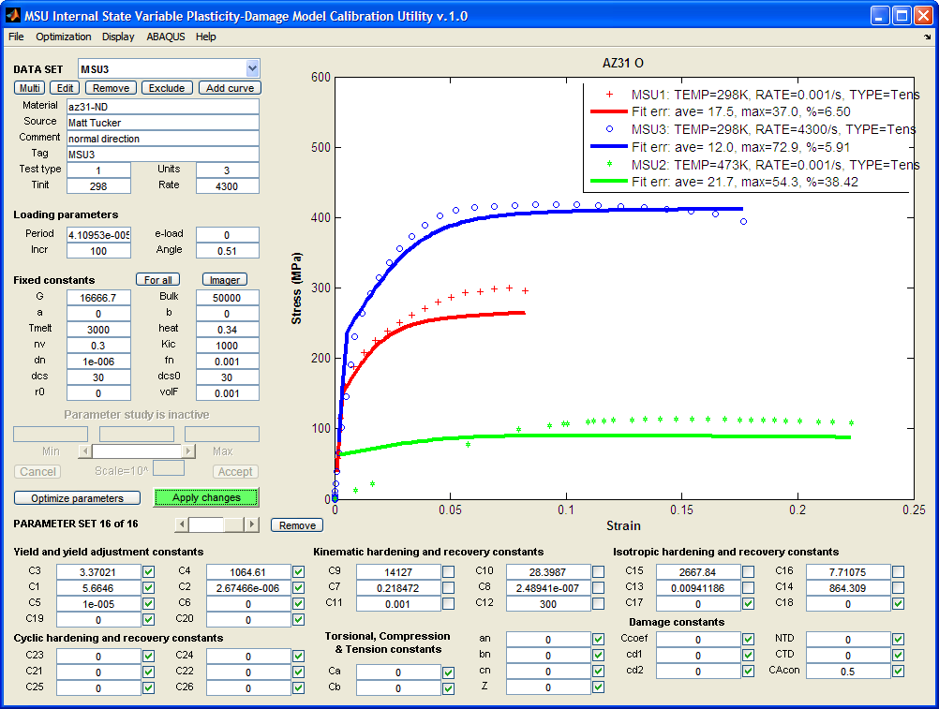
Add rate dependence to kinematic hardening & recovery: C11=0.001, C12=300; check C1, C2; “Apply”; “Optimize”

Slide 38
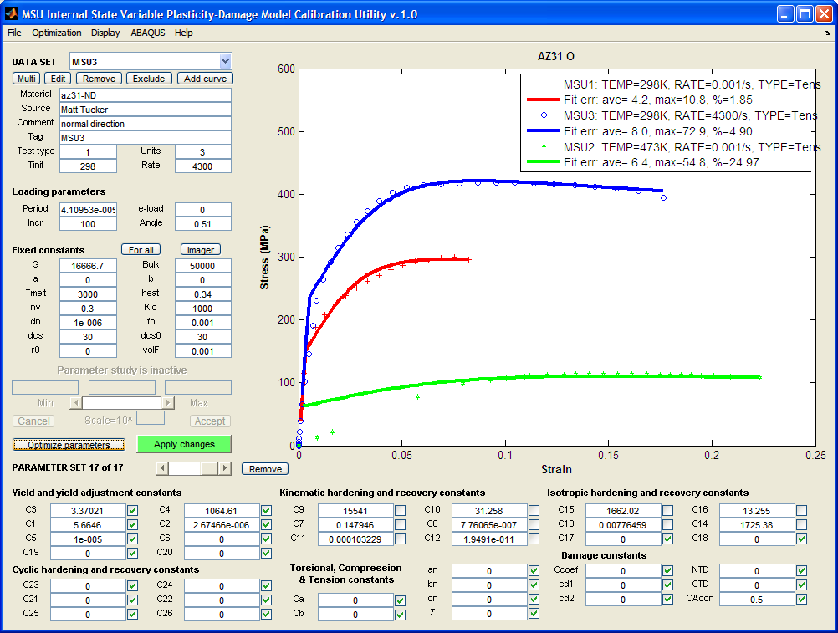
After “Optimize”

Slide 39
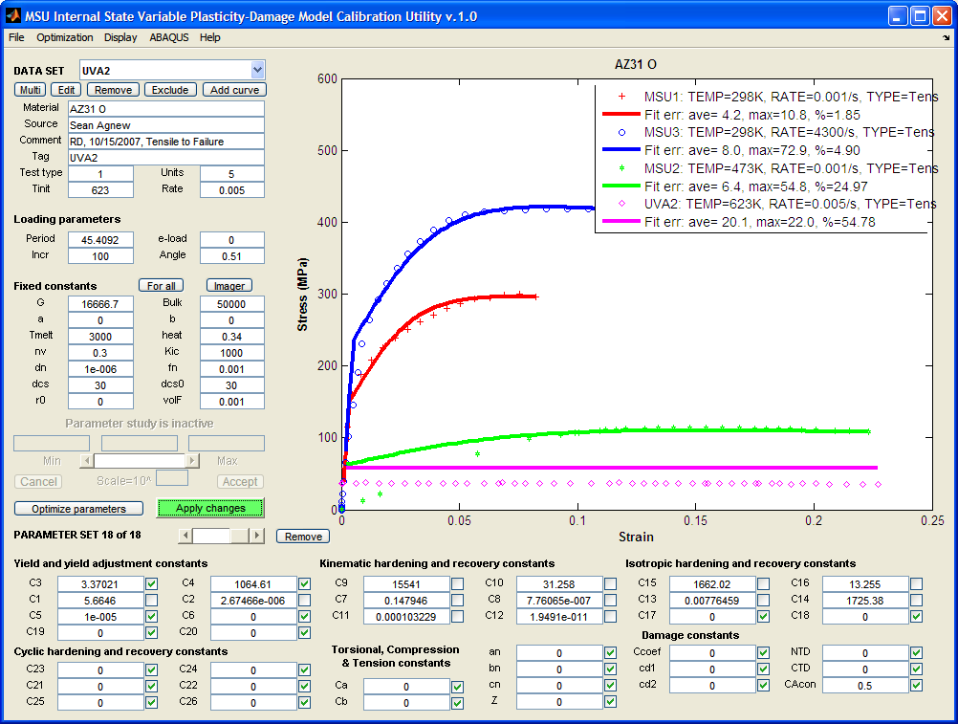
Restore UVA2; uncheck C1, C2; Apply; “Optimize”

Slide 40
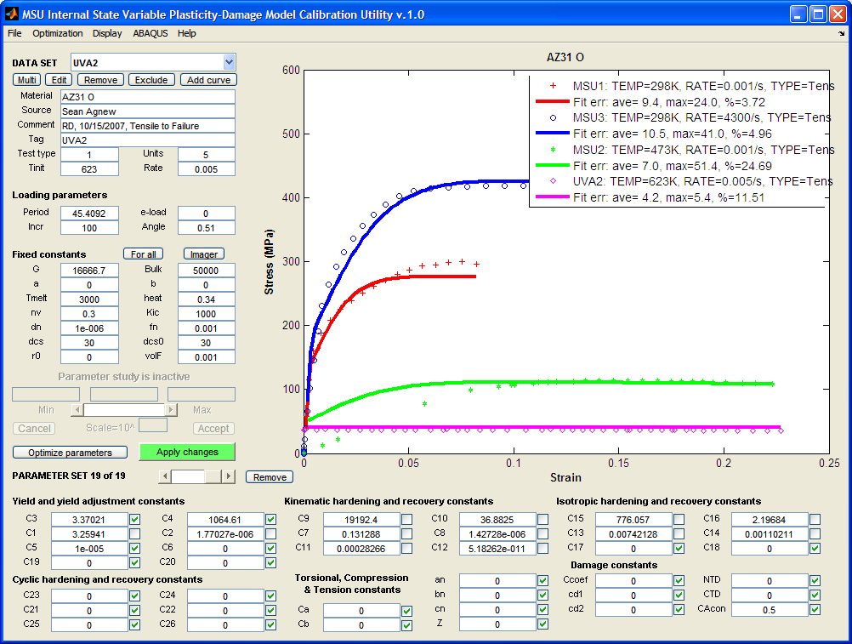
After “Optimize”

Slide 41
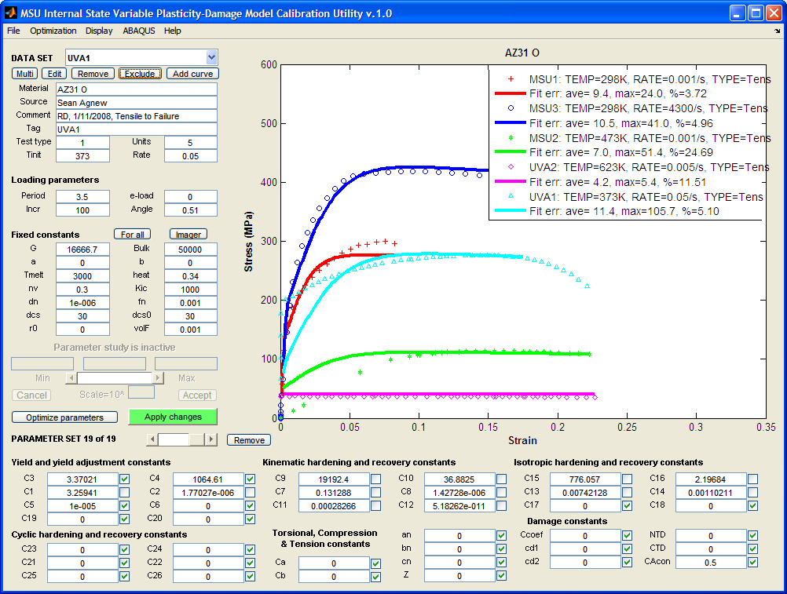
Restore UVA1, set Period=3.5; “Apply”; “Optimize”

Slide 42
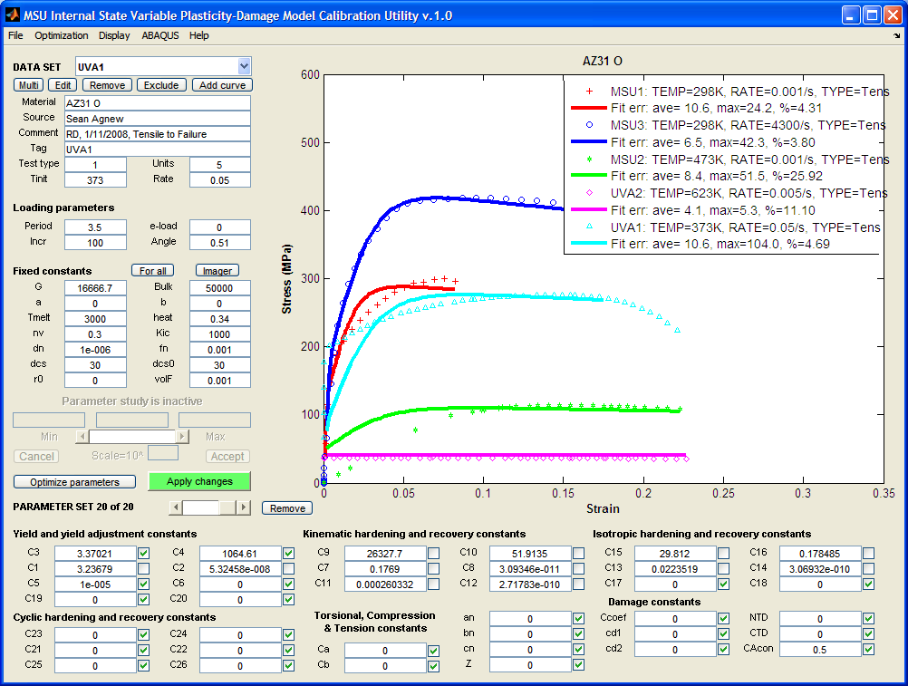
After “Optimize”

Slide 43
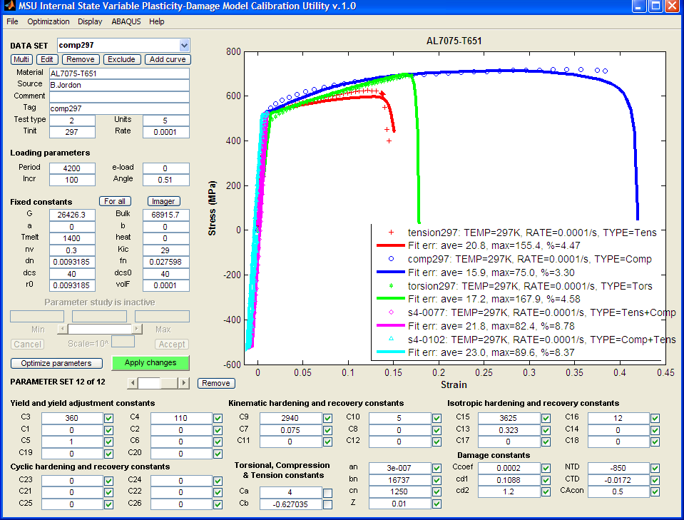
Example with compression, tension, and torsion data; damage: AL7075-T651

Slide 44
Step 7
Record results.
Select File | Write | A “USER MATERIAL, CONSTANTS” for ABAQUS to merge the constants to an existing ABAQUS input deck, or to create a text file containing the constants, suitable for inclusion in an ABAQUS input deck.
Select File | Write | A binary restart file to create a record of your session, to resume the session later.
Select File | Write | A “fitted constants+ constraints” file to create a text file containing the fitted constants, which may be used as starting values in future fitting sessions.
Select File | Write | A post-processing info text file, for import into MS Excel.

Slide 45
Some DMGfit features
Interactive parameter study
Recall/discard attempted fits
Invoke ImageAnalyzer to calculate microstructure constants
Merge constants into an ABAQUS input deck
Submit job (UMAT + input deck) to ABAQUS
submit/retrieve 1-element jobs, for model verification vis-à-vis ABAQUS simulation
(See Help | Topics for other labor saving features)

Slide 46
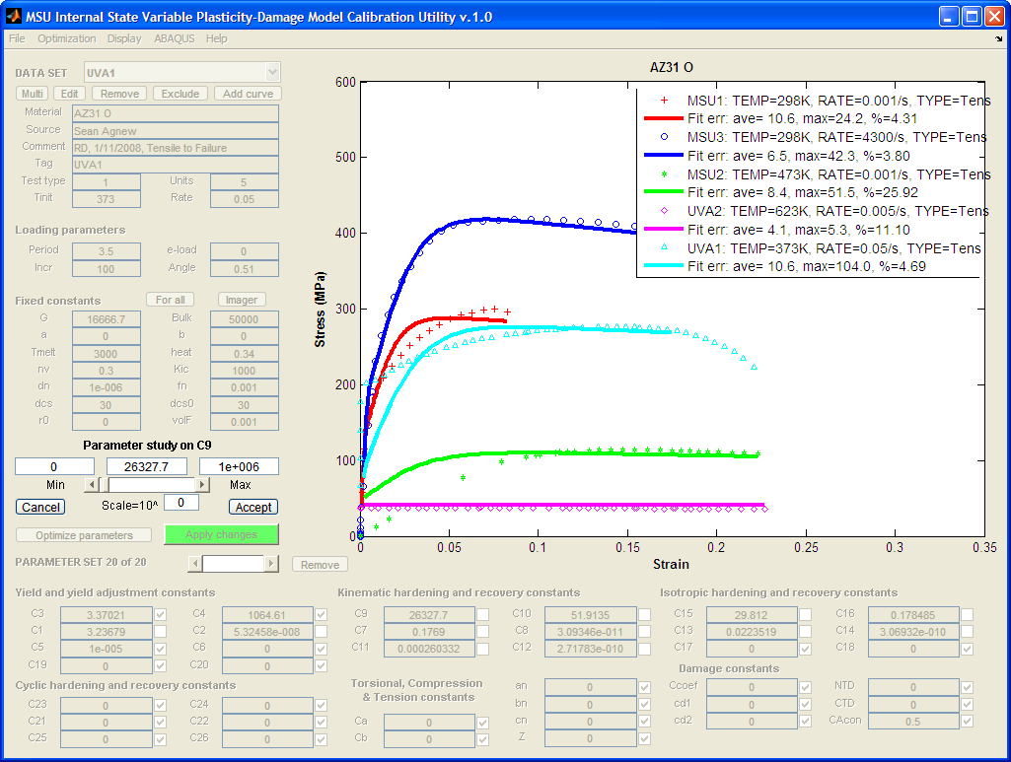
Feature: Interactive “Parameter Study”
a. Right-click on value for parameter
b. Specify min & max values
c. Click on slider to select the
current value.
d. Enter an exponent for the
scale if working with very small
or very large values
e. Click “Accept” if done, or
“Cancel” for no changes
b
a
c
e
d
e

Slide 47
Feature: Navigate attempted fits
Navigate the
parameter sets
Discard current
parameter set
Notes:
A right-click on “Remove” gives the option to discard ALL parameter sets (i.e., start over).

Slide 48
Feature: Invoke ImageAnalyzer to calculate microstructure constants
The “Fixed constants” may be unique
for each dataset. “For all” forces
the displayed constants to be used
for all datasets.

Slide 49
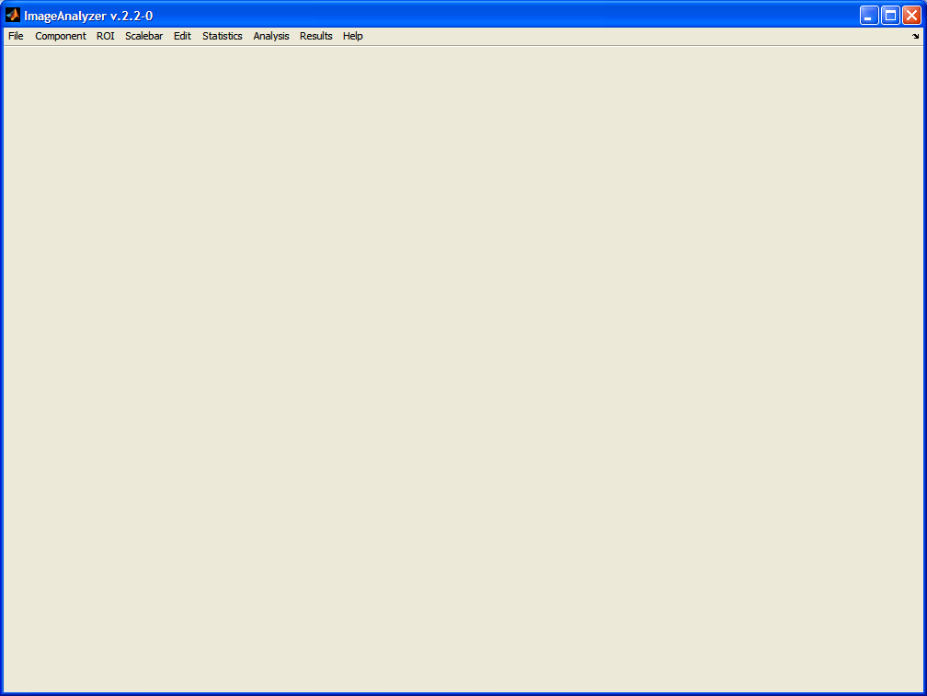
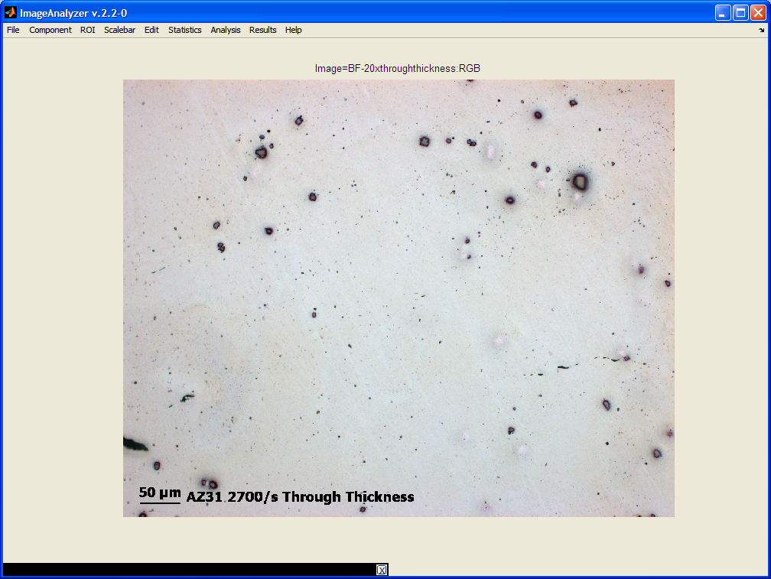
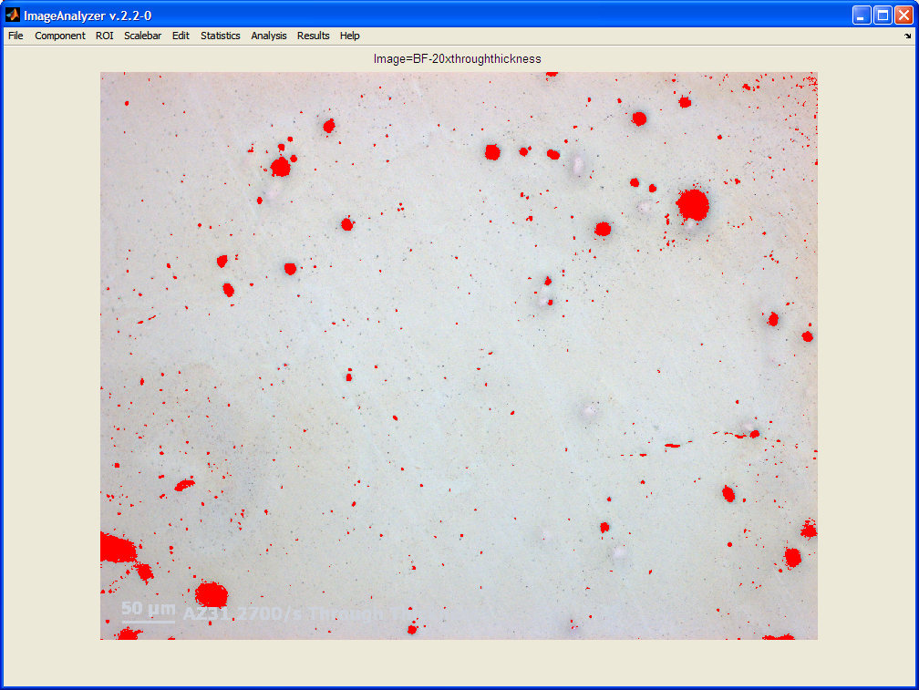
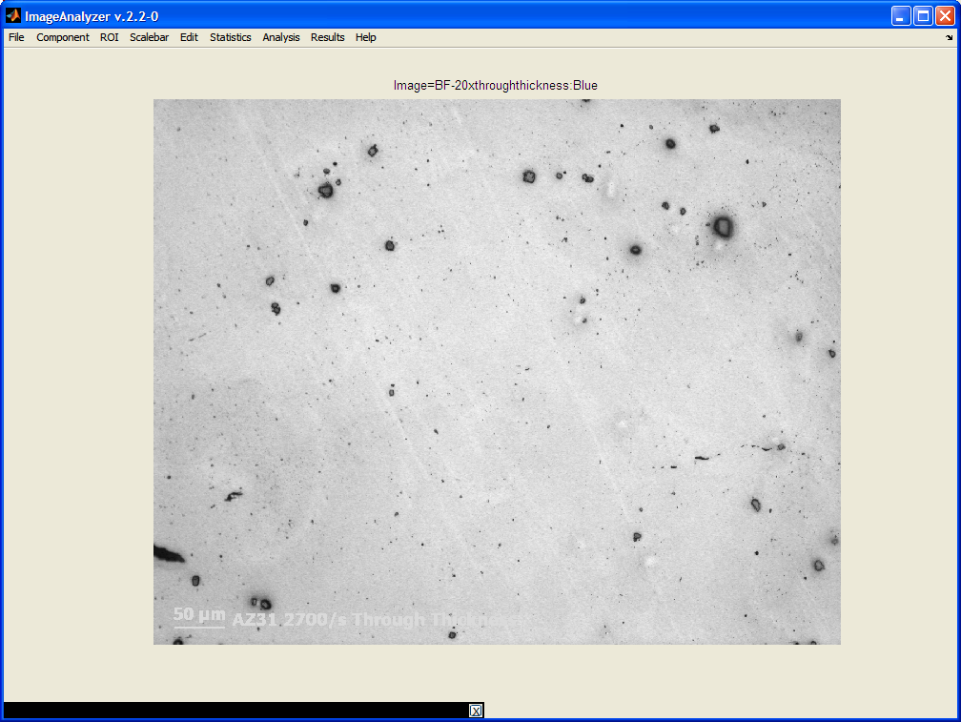
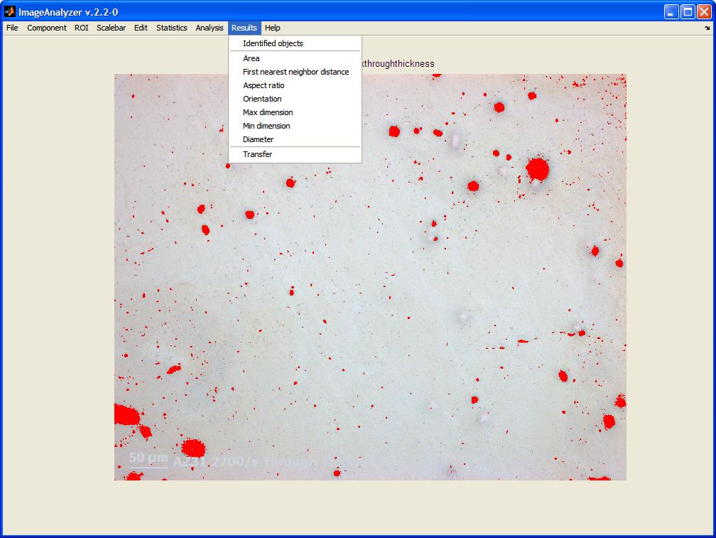
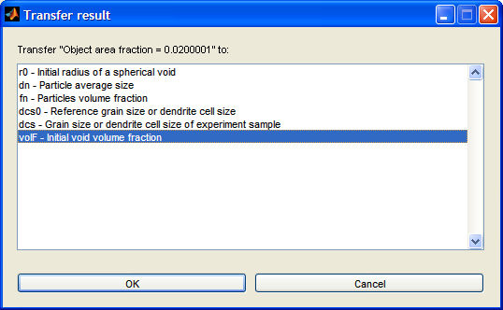
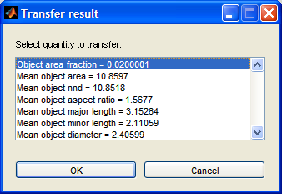
Feature: Invoke ImageAnalyzer to calculate microstructure constants (cont)

Slide 50
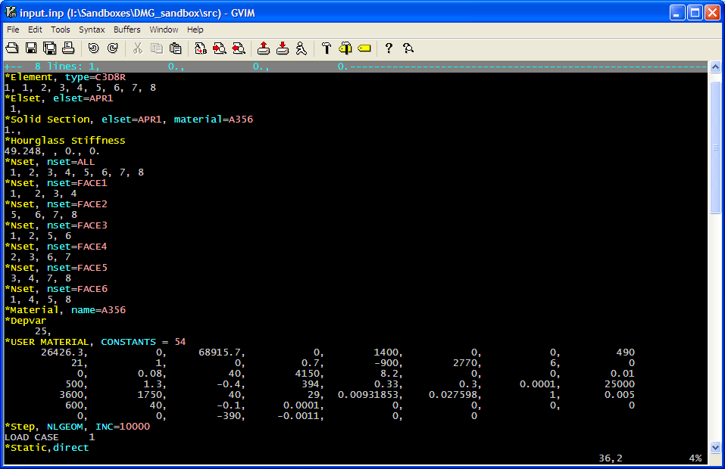
Feature: Merge constants into an existing ABAQUS input deck
Example ABAQUS input
Manual update of these constants
very tedious and error-prone

Slide 51
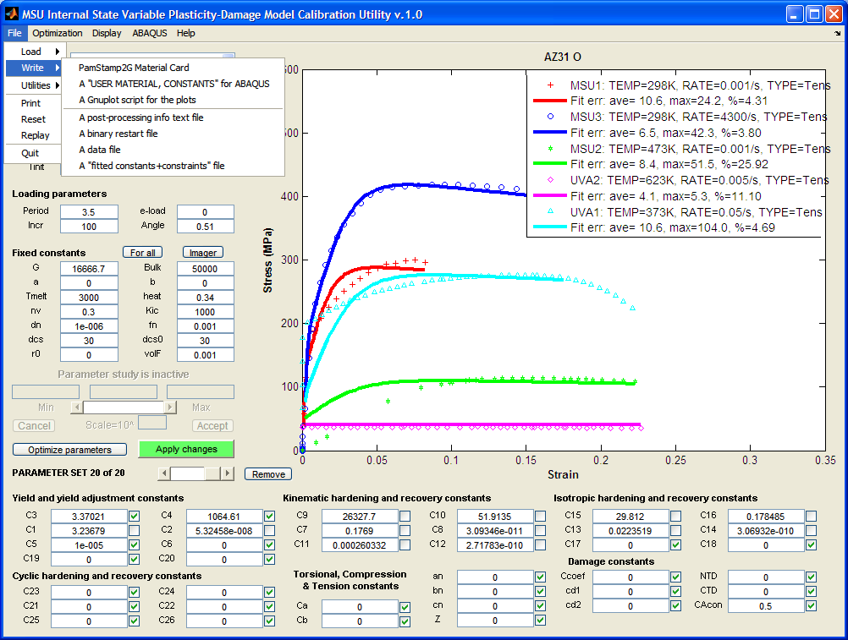
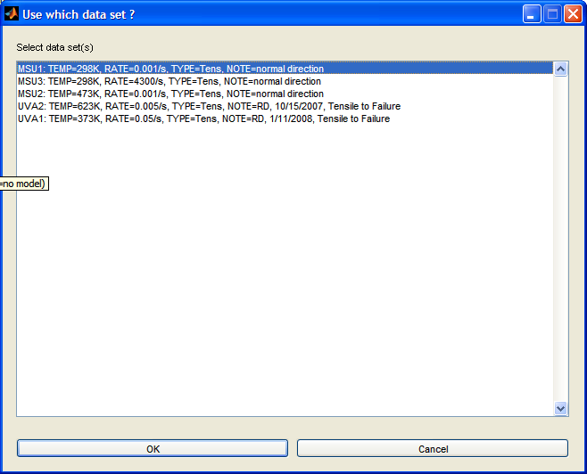
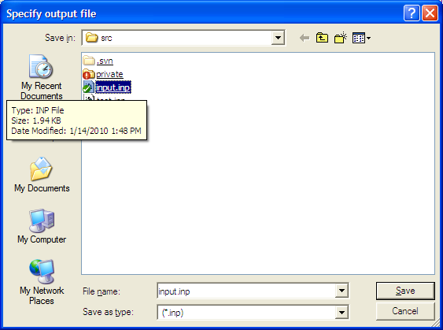
Merge constants into an existing ABAQUS input deck (cont)
Select one dataset as the
source of fixed constants
Select an existing ABAQUS
Input deck

Slide 52
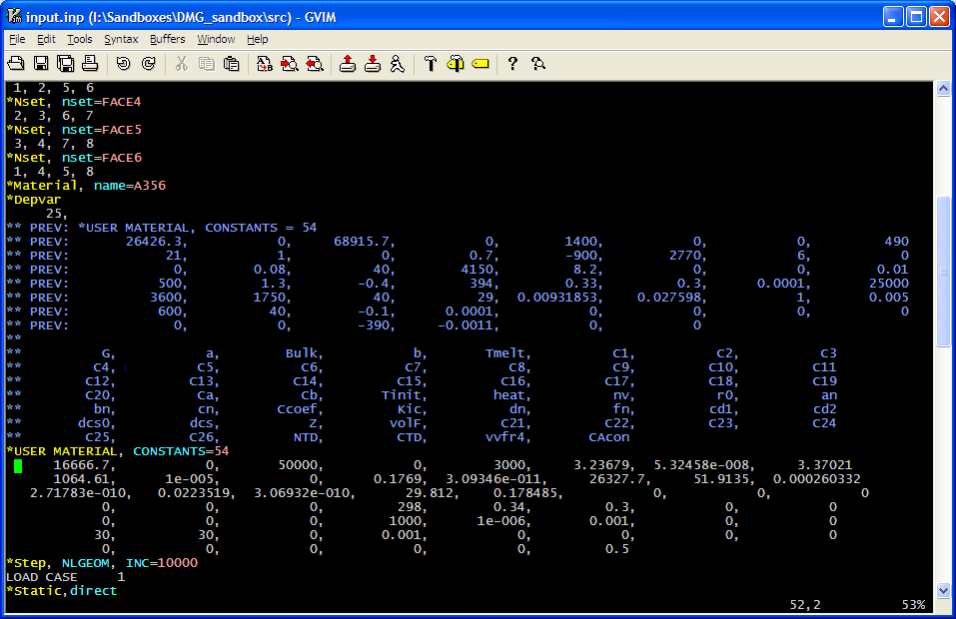
Merge constants into an existing ABAQUS input deck (cont)
Previous constants
Constants from DMGfit

Slide 53
Feature: Submit to ABAQUS (if available and configured on DMGfit machine)
For 1-element job using the
input deck provided: extract
the stress-strain model from
ABAQUS output files

Slide 54
-End of Presentation-

